Slide 1
Mercury For Dinner?
Aqueous Heavy Metal Sequestration
Jacob Kjeldahl Jensen
Dr. Chris Monson

Slide 2
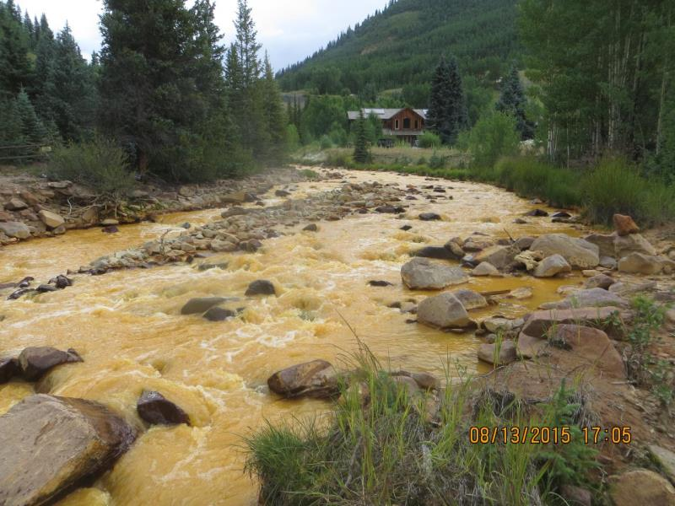
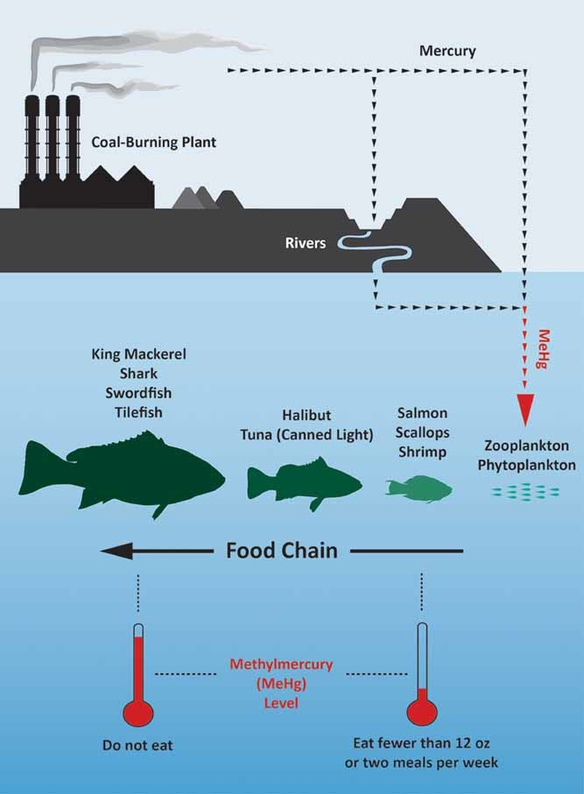

Inspiration
Gold King Mine Accident, 2015¹
Mercury Emission²
Especially harmful during pregnancy
Notes:
¹ https://www.epa.gov/goldkingmine
Colorado
Cement Creek
3 million gallons wastewater
² Hammerschmidt, C.R. (2011), Mercury and carbon dioxide emissions: Uncoupling a toxic relationship. Environmental Toxicology and Chemistry, 30: 2640-2646. https://doi.org/10.1002/etc.702

Slide 3
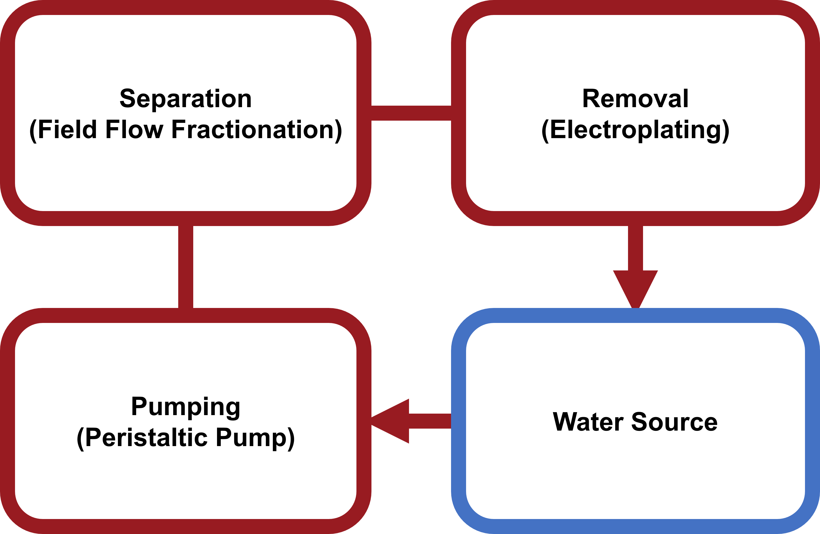
3 Step Process

Slide 4
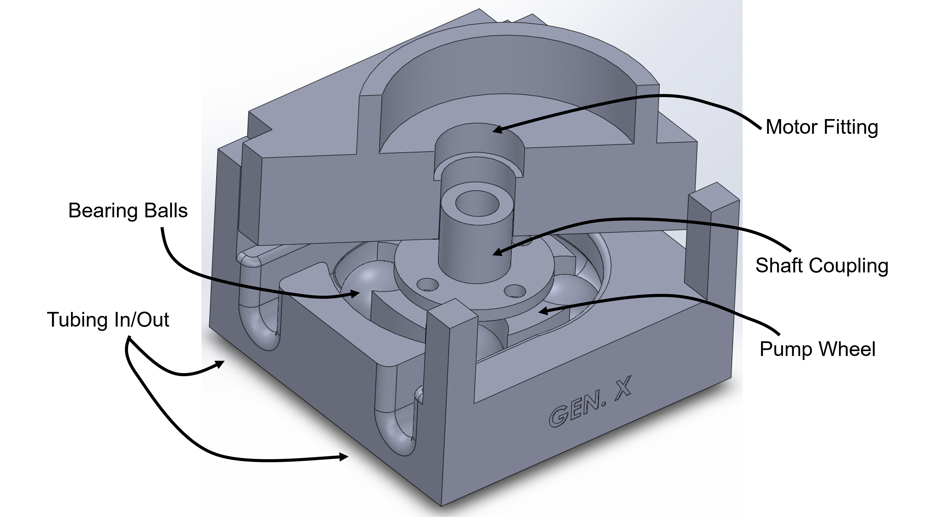
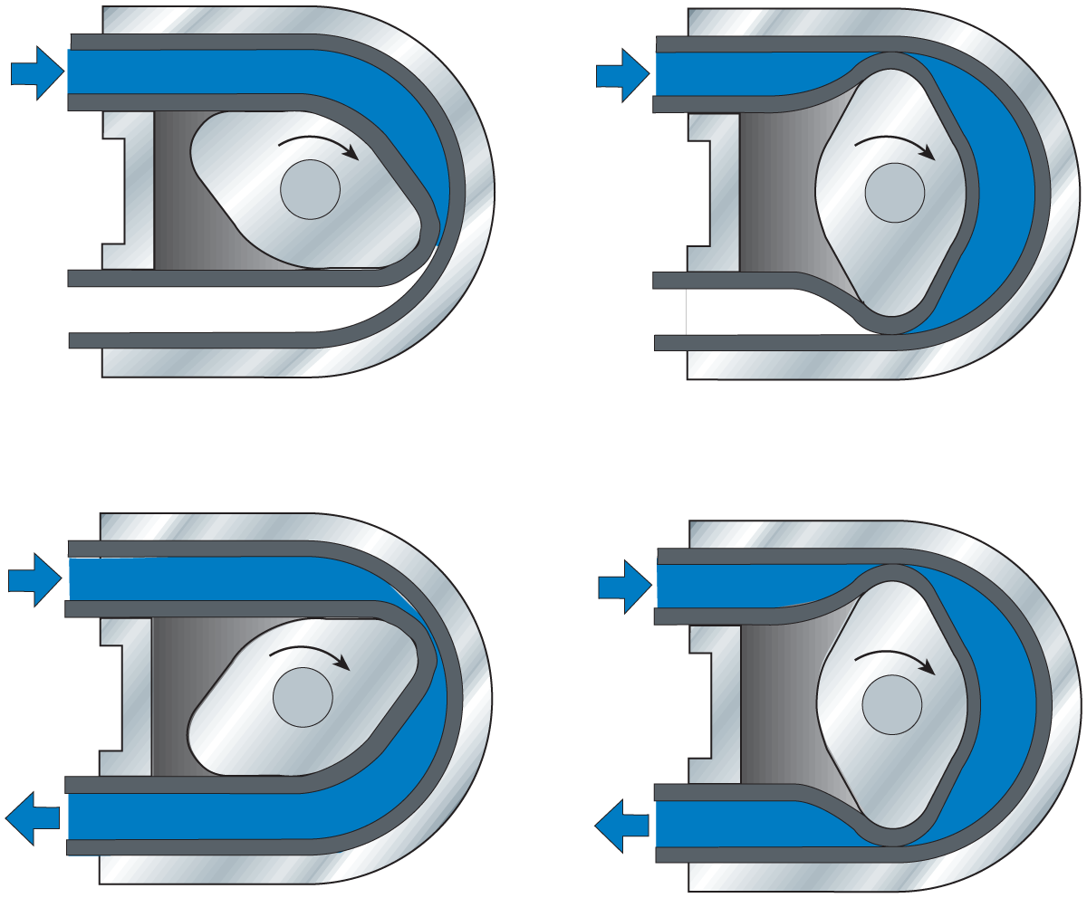
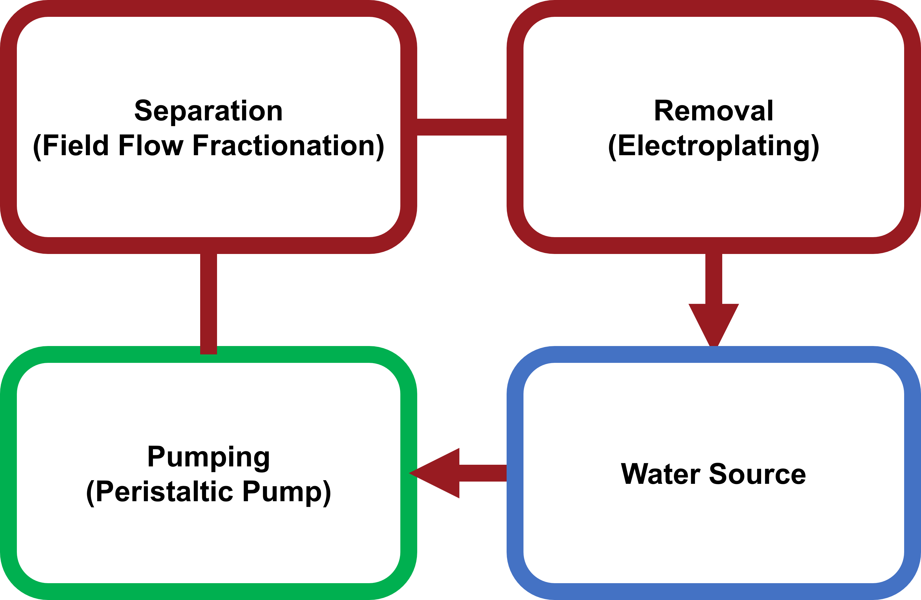
Pumping – Peristaltic Pump

Slide 5
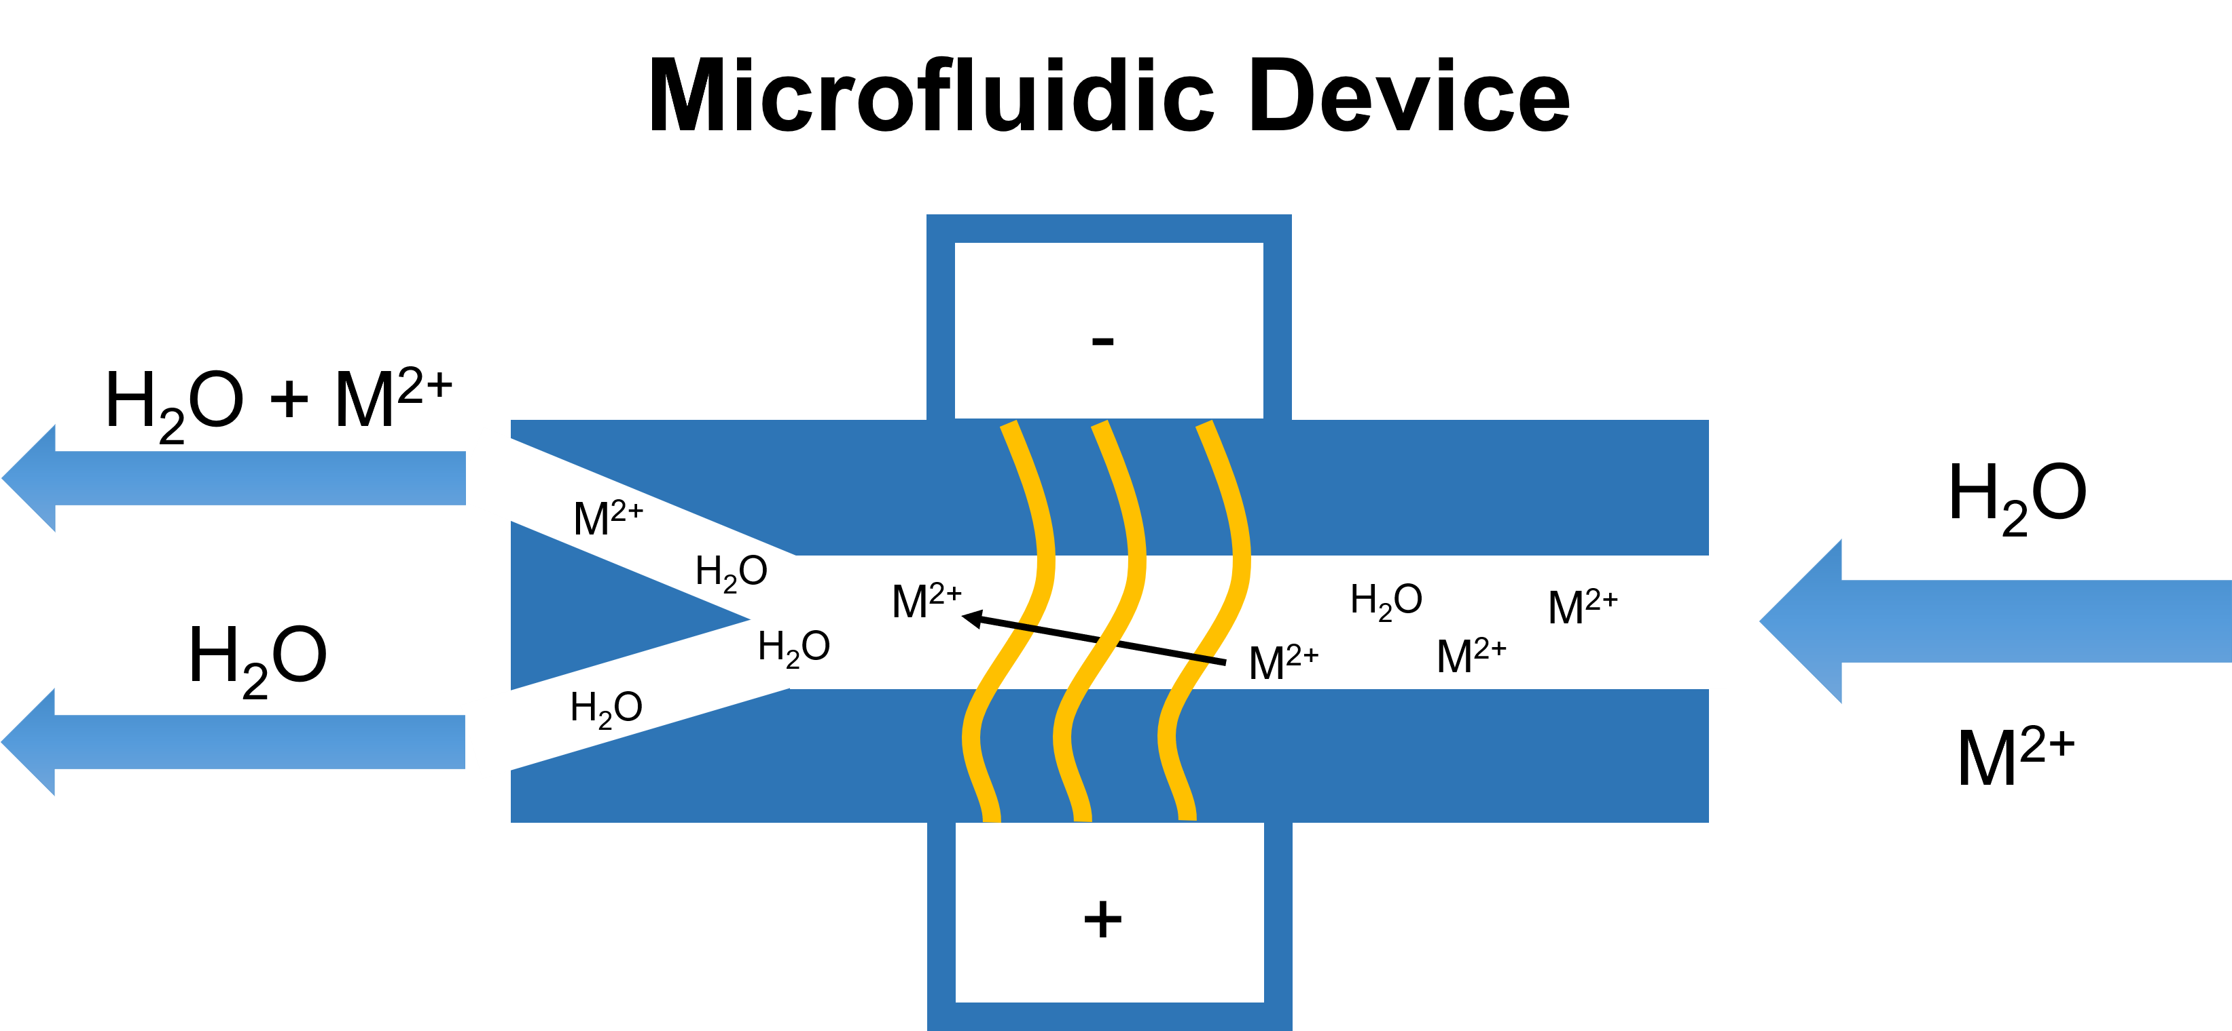
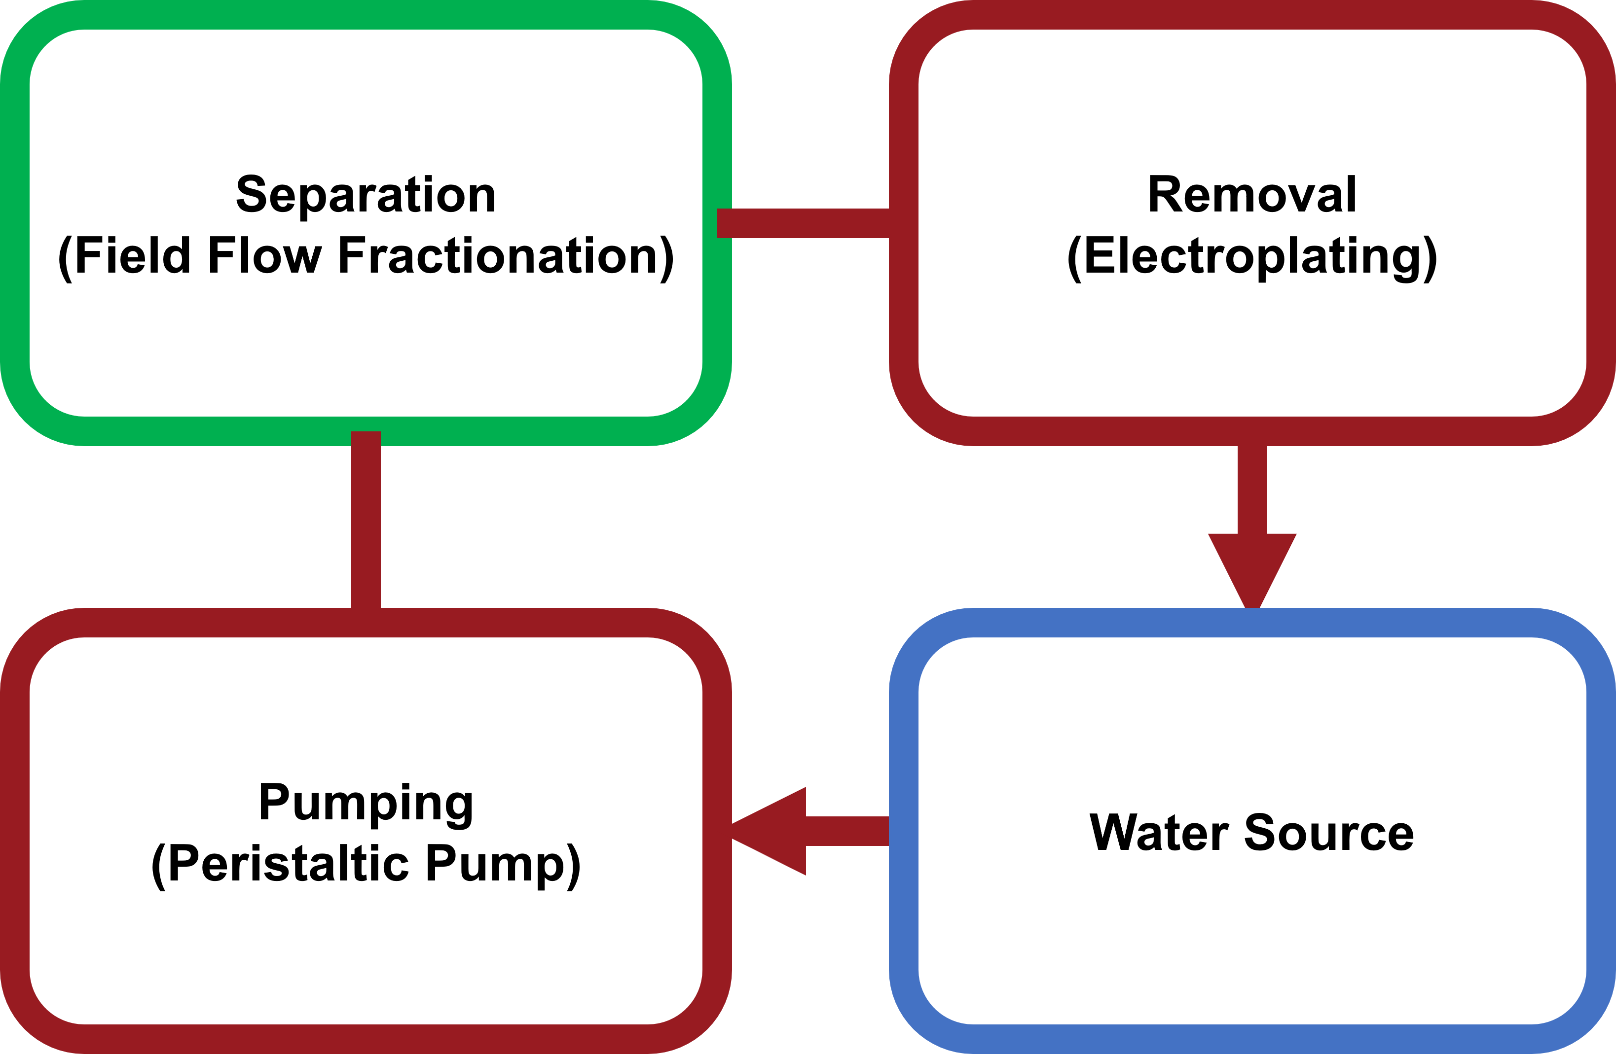
Separation – Field Flow Fractionation

Slide 6
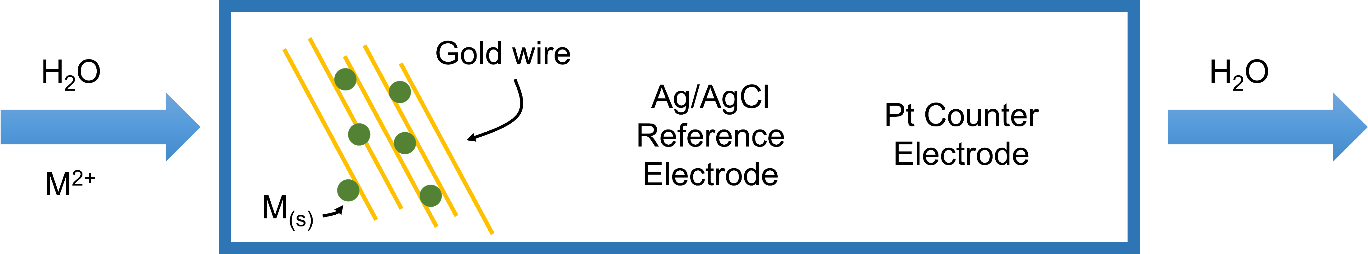
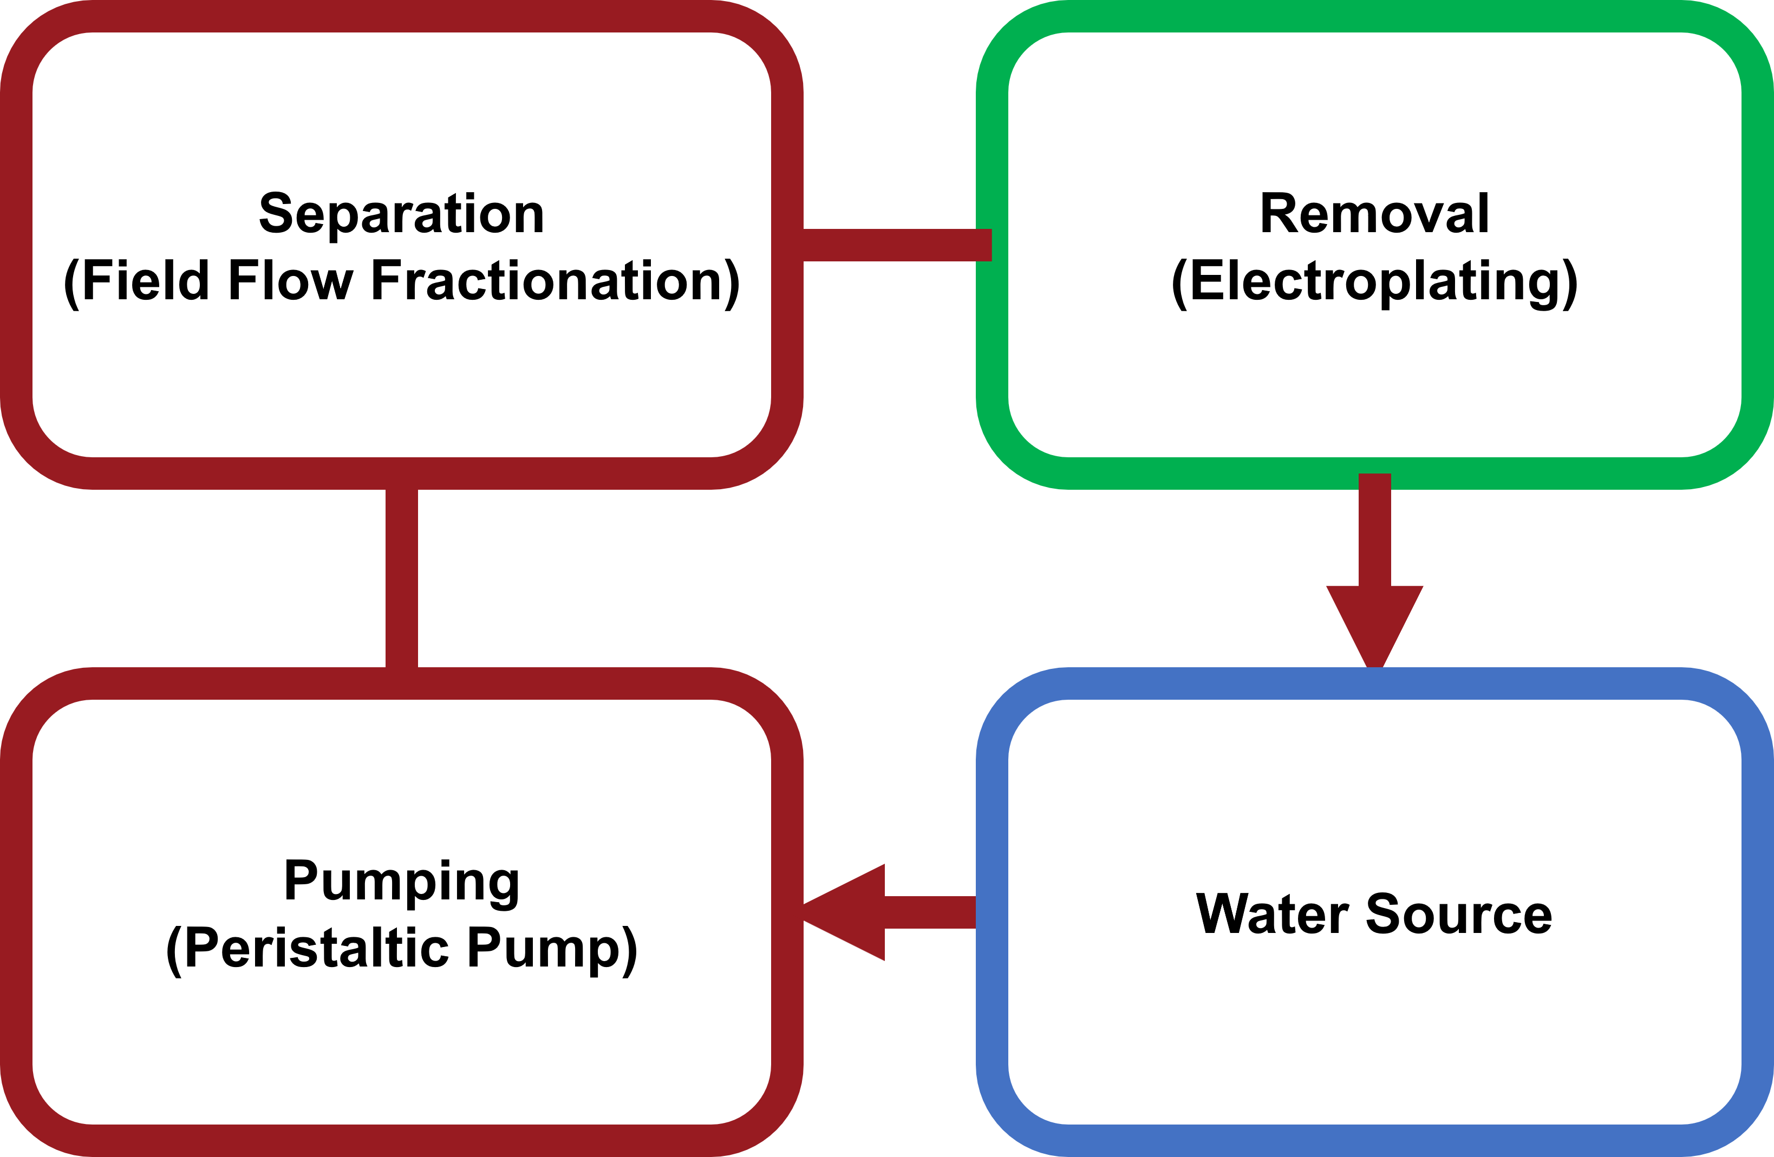
Removal – Sequestration by electroplating

Slide 7

Removal Process
e⁻
M²⁺
M_{(s)}
M²⁺
e⁻
e⁻
e⁻

Slide 8
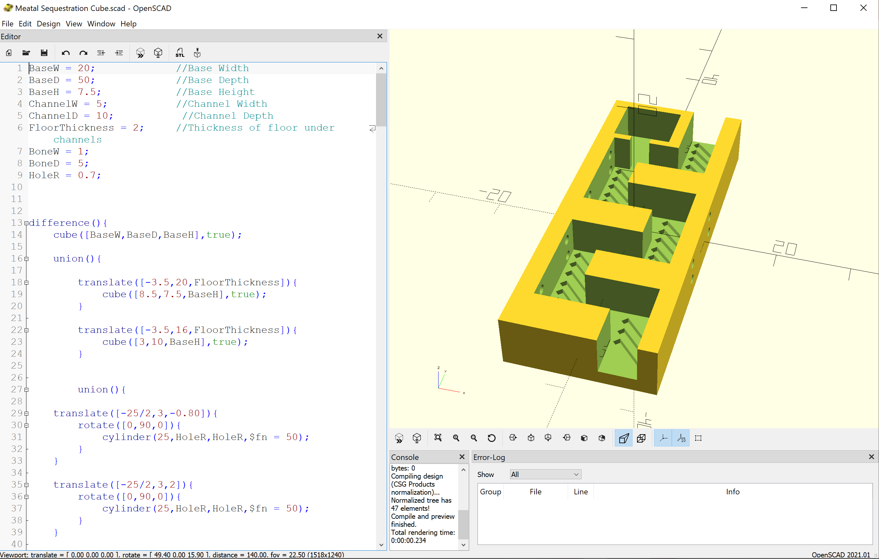
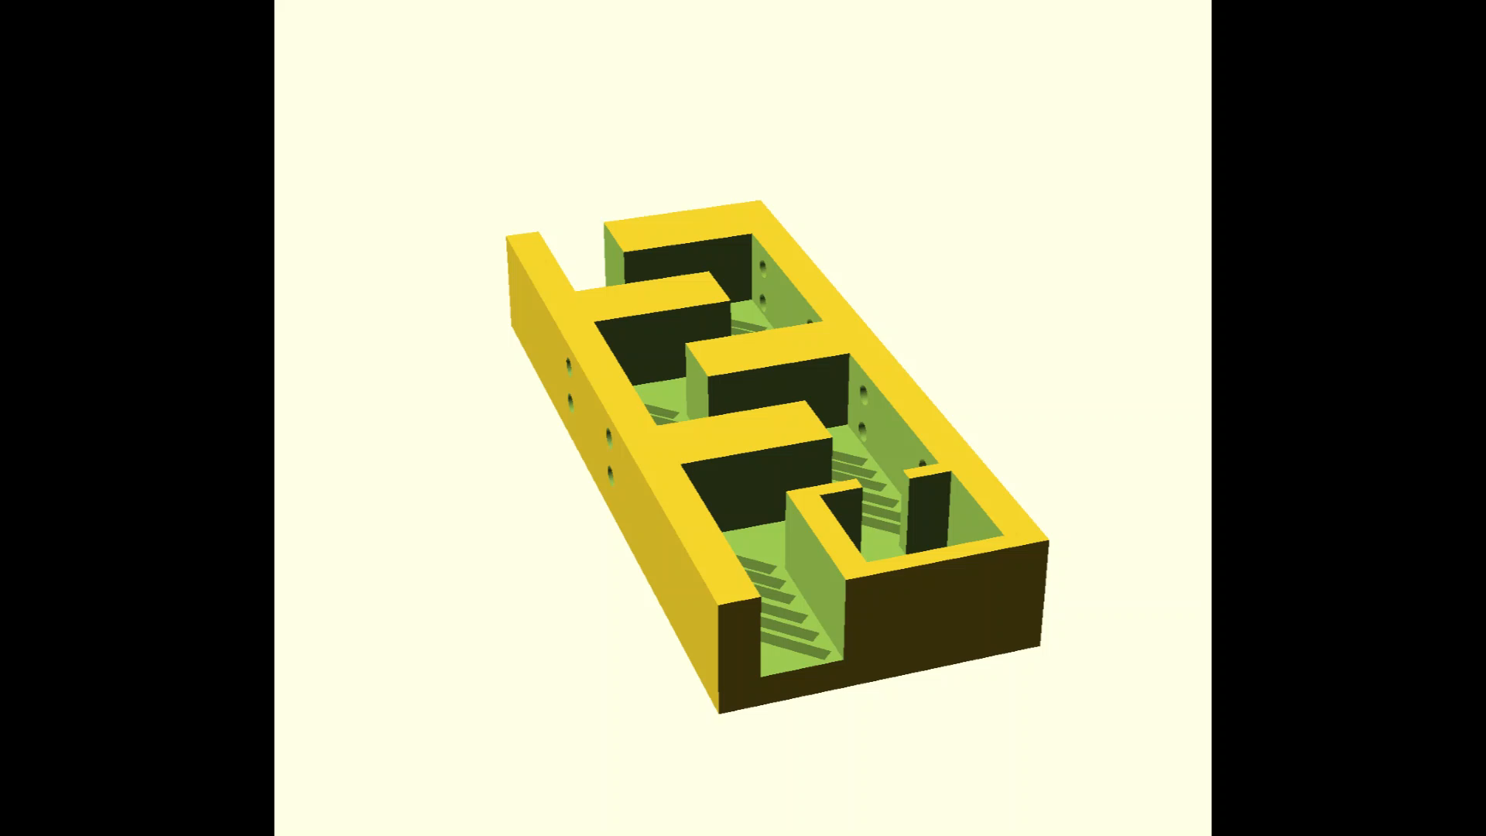
Current Sequestration Device

Slide 9
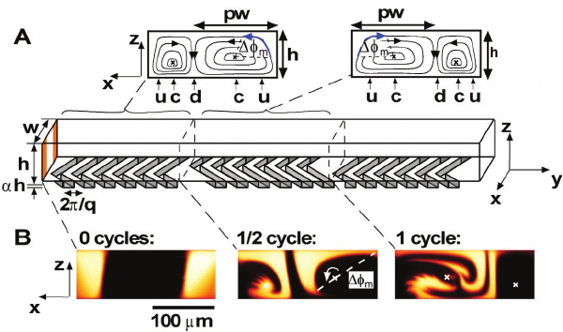
Herringbone Passive Mixing
Illustration from “Chaotic Mixer for Microchannels” by Stroock, Abraham et al. ¹
Notes:
¹ Stroock, Abraham & Dertinger, Stephan & Ajdari, Armand & Mezic, Igor & Stone, Howard & Whitesides, George. (2002). Chaotic Mixer for Microchannels. Science (New York, N.Y.). 295. 647-51. 10.1126/science.1066238.

Slide 10
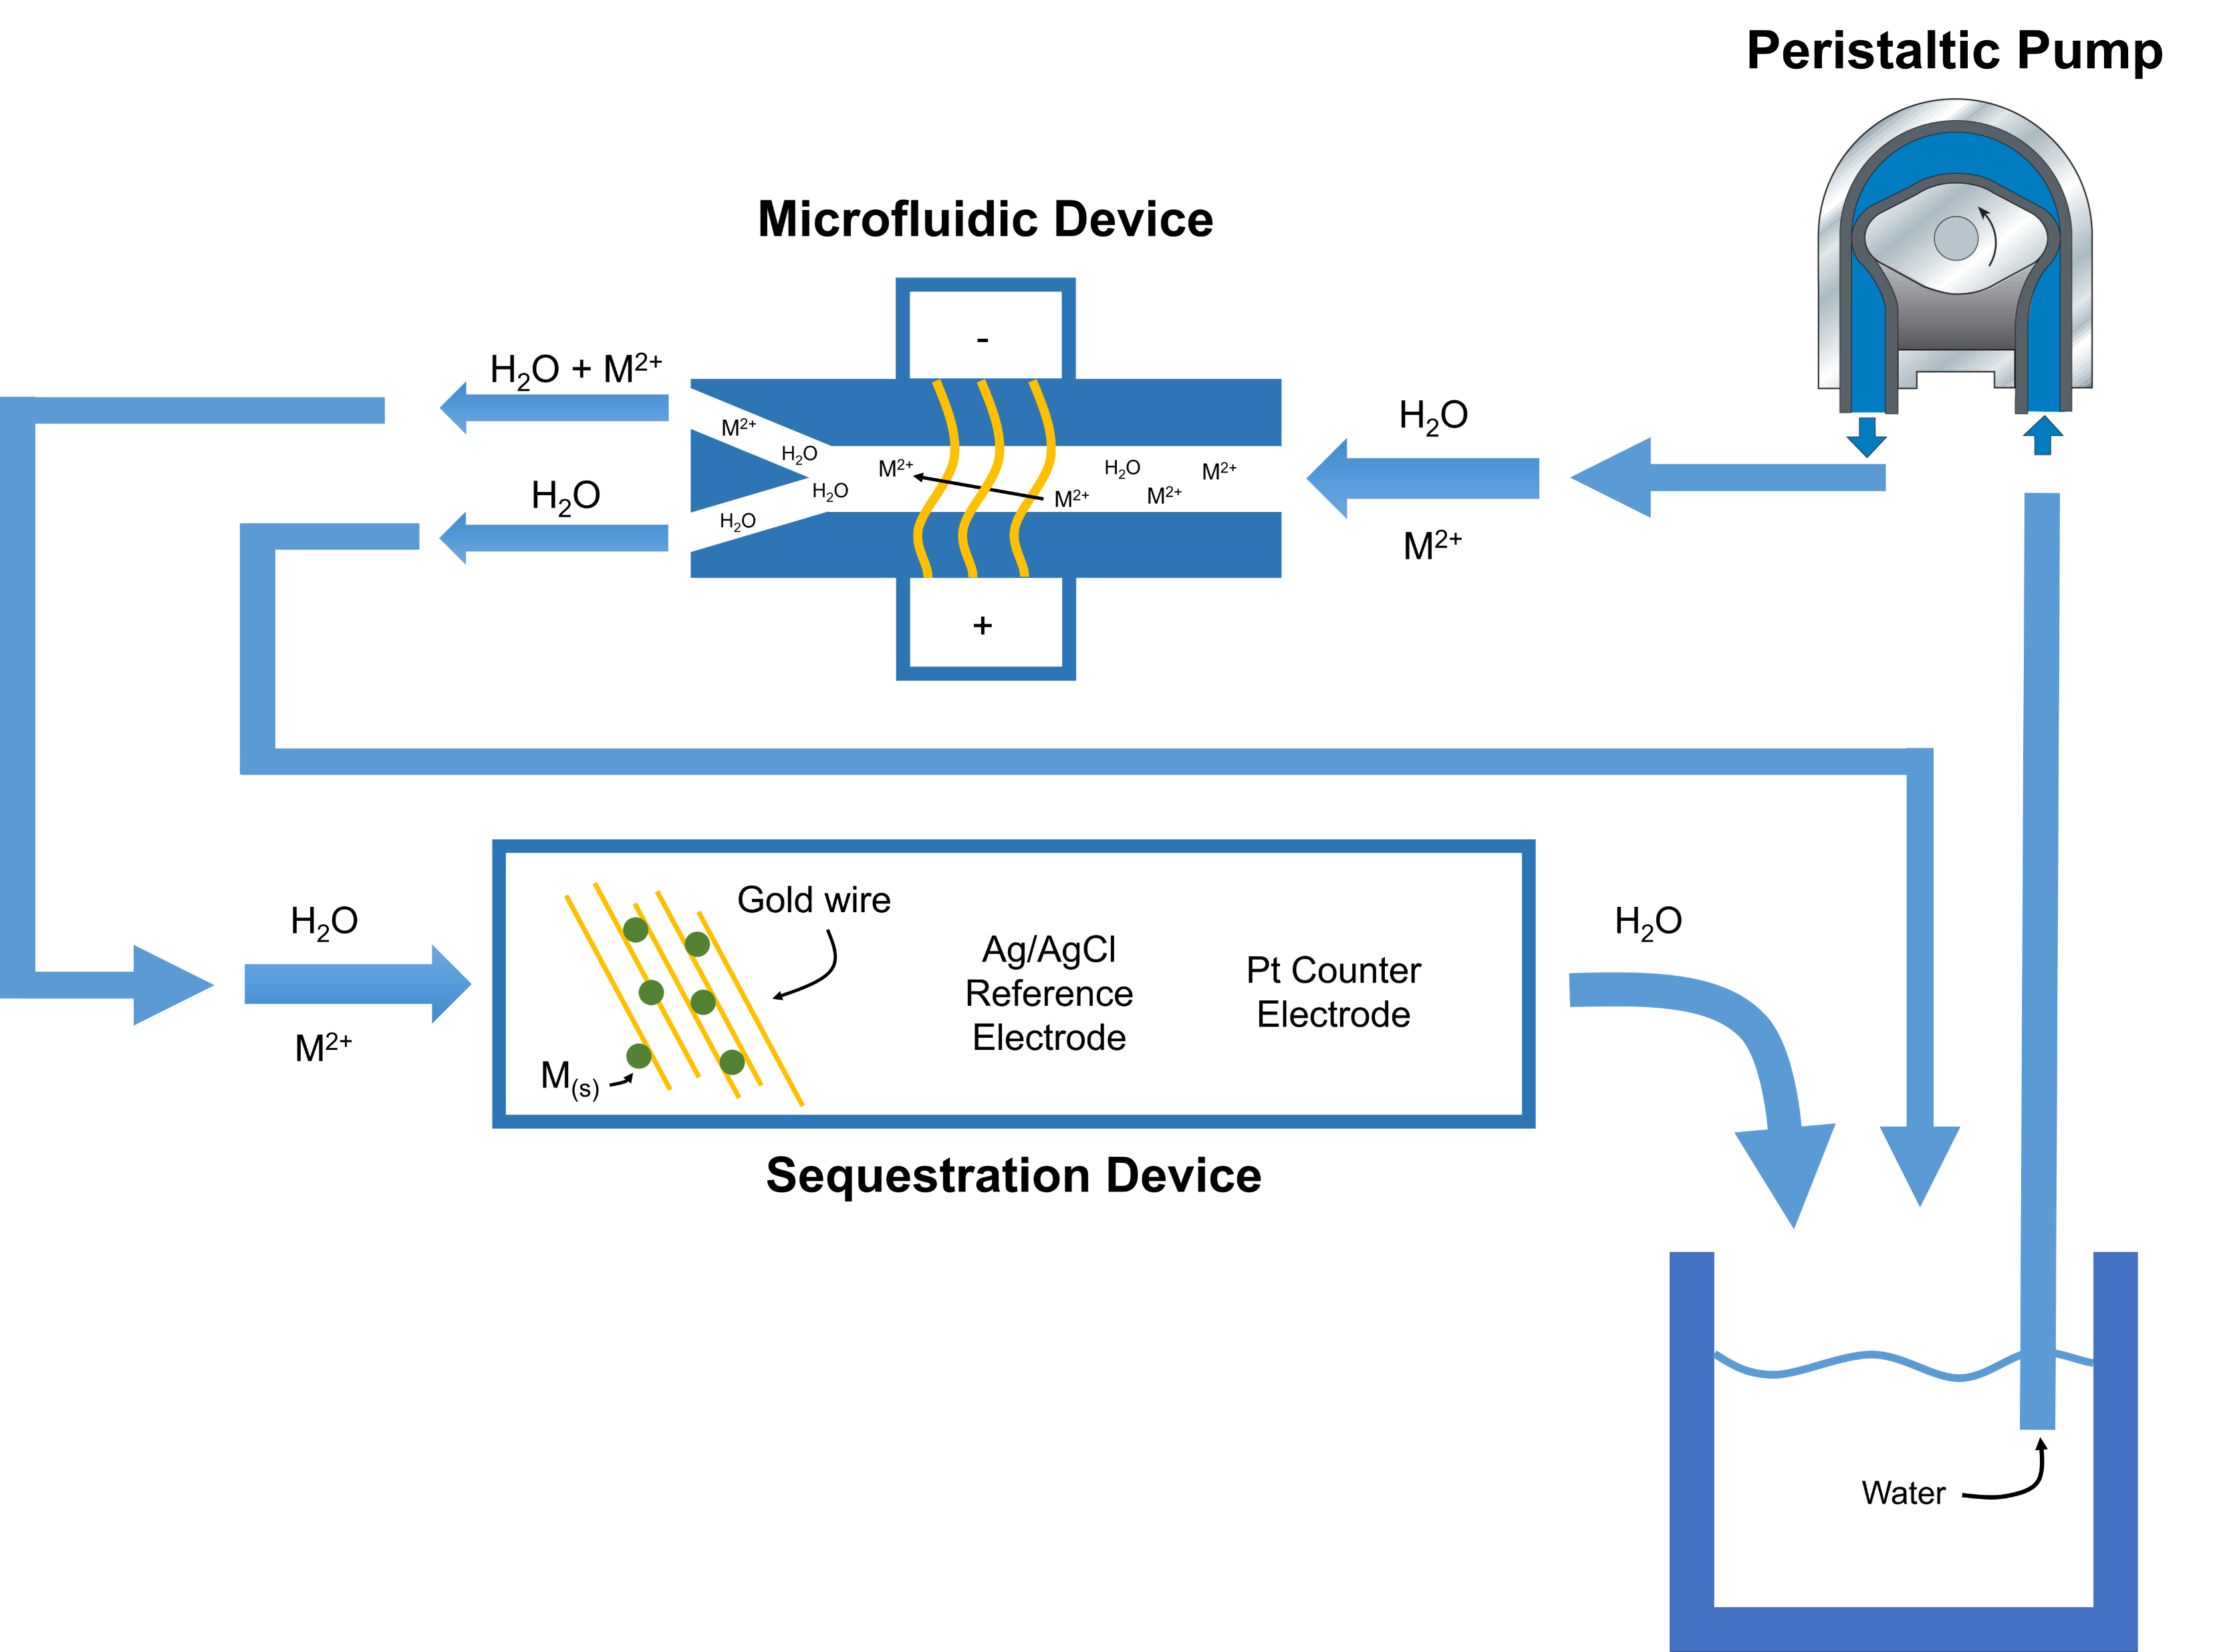
Overview

Slide 11



The Future – Adding Solar Panel

Slide 12
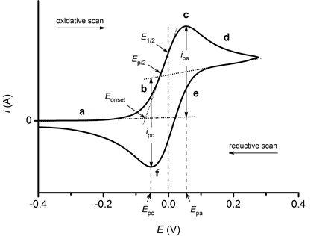
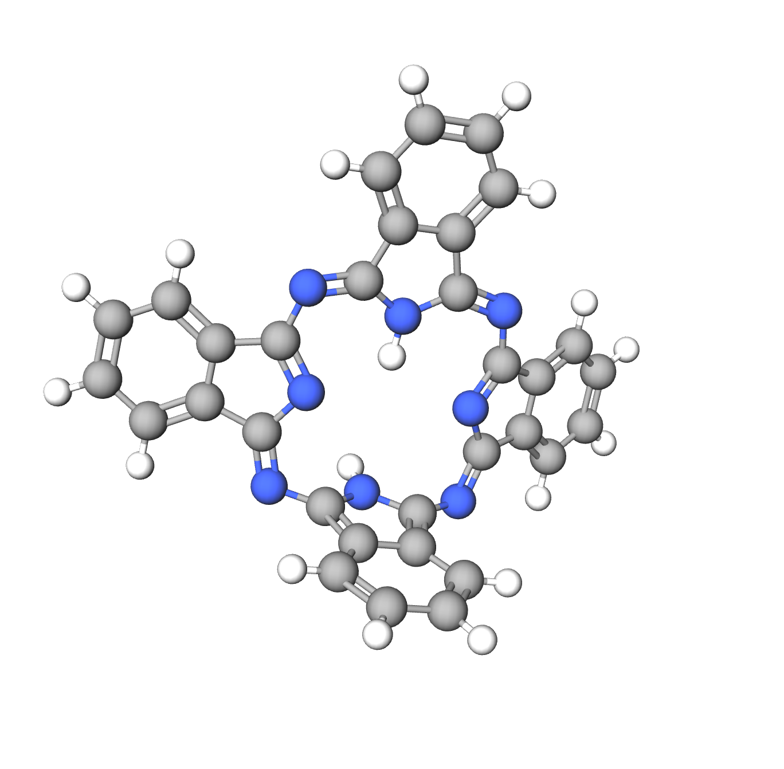
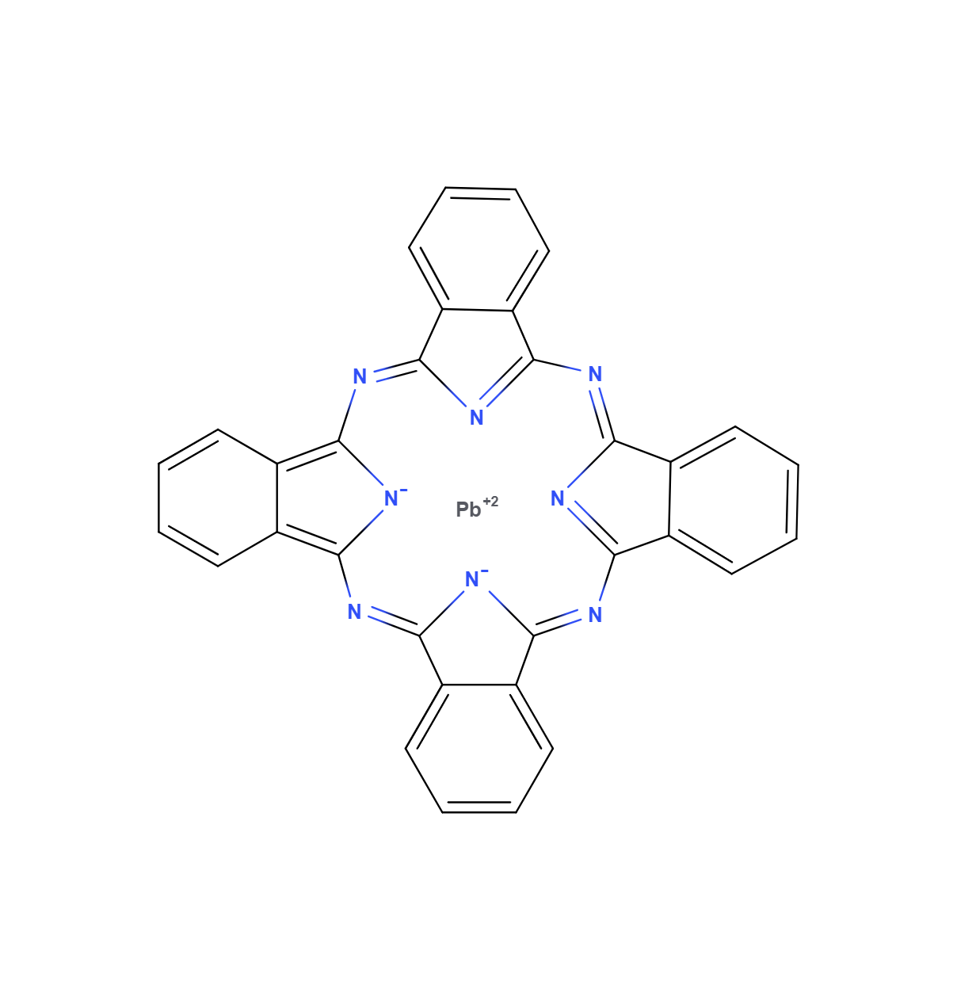
The Future – Testing
Electrochemistry
UV–vis spectroscopy
w/ suitable ligand
ICP MS
- For low concentrations
Notes:
Cyclic voltammogram

Slide 13
Acknowledgements
L.S. and Aline W. Skaggs – Funding
Dr. Chris Monson – Mentor
THANK YOU!

Slide 14
Resources
Heavy Metal toxicity and the environment
Tchounwou, P. B., Yedjou, C. G., Patlolla, A. K., & Sutton, D. J. (2012). Heavy metal toxicity and the environment. Experientia supplementum (2012), 101, 133–164. https://doi.org/10.1007/978-3-7643-8340-4_6
Metal Mining Waste Management Trend
https://www.epa.gov/trinationalanalysis/metal-mining-waste-management-trend
Emergency Response to August 2015 Release from Gold King Mine
https://www.epa.gov/goldkingmine
Treatment Technology Evaluation for Aqueous Metal and Cyanide Bearing Hazardous Wastes (F007)
Sardar Q. Hassan, Michael P. Vitello, Margaret J. Kupferle & Douglas W. Grosse (1991) Treatment Technology Evaluation for Aqueous Metal and Cyanide Bearing Hazardous Wastes (F007), Journal of the Air & Waste Management Association, 41:5, 710-715, DOI: 10.1080/10473289.1991.10466871
Mercury and carbon dioxide emissions: Uncoupling a toxic relationship.
Hammerschmidt, C.R. (2011), Mercury and carbon dioxide emissions: Uncoupling a toxic relationship. Environmental Toxicology and Chemistry, 30: 2640- 2646. https://doi.org/10.1002/etc.702
Chaotic Mixer for Microchannels.
Stroock, Abraham & Dertinger, Stephan & Ajdari, Armand & Mezic, Igor & Stone, Howard & Whitesides, George. (2002). Chaotic Mixer for Microchannels. Science (New York, N.Y.). 295. 647-51. 10.1126/science.1066238.

Slide 15

Presentation Uploaded To My Website
JACOBKJELDAHL.COM

Slide 16



Questions, Thoughts, Ideas?

Slide 17
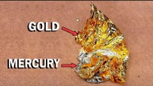
Gold vs. Mercury
 | Gold | Mercury
Melting Point | 1,064 Celsius | -38.83 Celsius
Boiling Point | 2,700 Celcius | 355.7 Celsius
Mercury + Gold forms an amalgam
Used in gold-extraction.
Mercury is vaporized to extract the gold from the alloy
Dissolving Gold in Mercury - NileRed

Slide 18


Standard Reduction Potentials
Standard Reduction Potentials of Half-Cells at ${25}^{∘} Celcius$
https://www.gov.nl.ca/education/files/k12_evaluation_chem3202_standardreductionpotentials.pdf
e⁻
e⁻
M²⁺
M_{(s)}

Slide 19
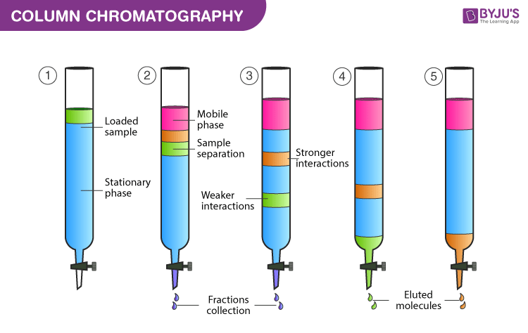
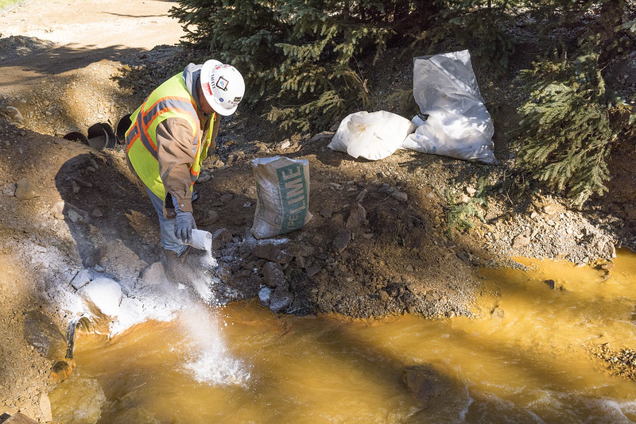
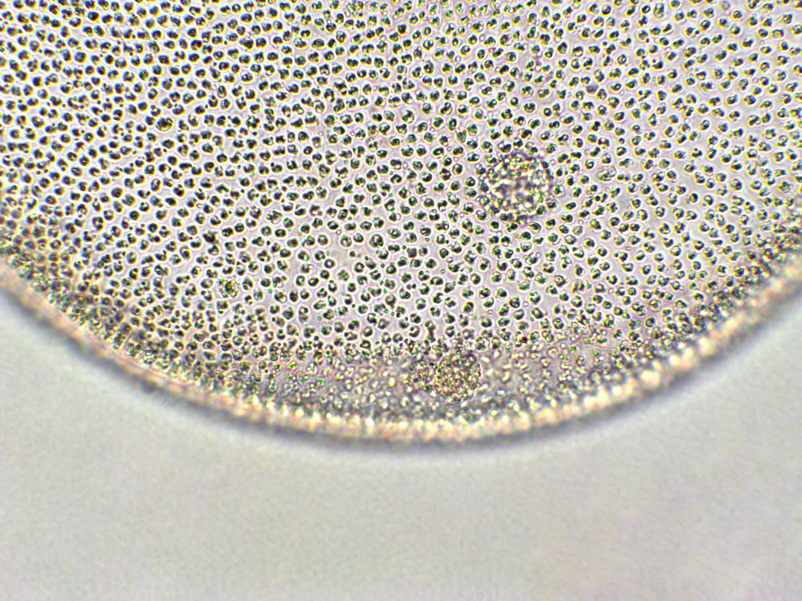
Alternatives
Precipitation Chromatography Membranes
Basic lime precipitates metal hydroxides.
Increases pH of solution.
Notes:
Chromatography
- https://byjus.com/chemistry/column-chromatography/

Slide 20
Priority Metals
Metal waste from anthropogenic (human) activities
  Arsenic, Cadmium, Chromium, Lead, and Mercury¹
Notes:
¹ Heavy Metal toxicity and the environment
Tchounwou, P. B., Yedjou, C. G., Patlolla, A. K., & Sutton, D. J. (2012). Heavy metal toxicity and the environment. Experientia supplementum (2012), 101, 133–164. https://doi.org/10.1007/978-3-7643-8340-4_6

Slide 21

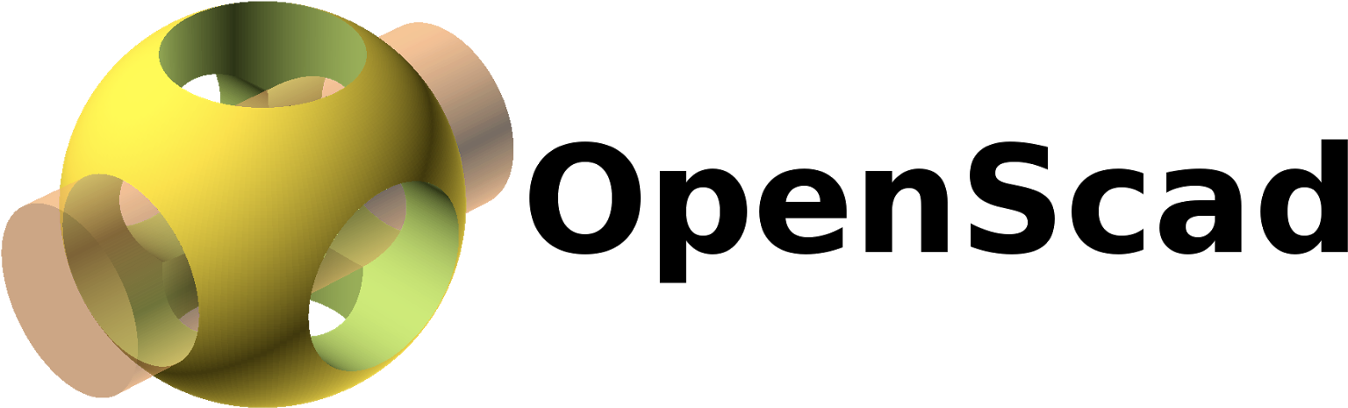


3D Modeling Software
Drawing
Programing
Expensive
Free

Slide 22
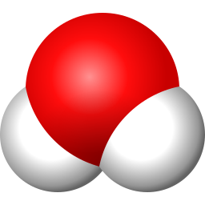

Molecular Visuals
Obtained from MolView. A free molecular drawing software.
Notes:
¹ Heavy Metal toxicity and the environment
Tchounwou, P. B., Yedjou, C. G., Patlolla, A. K., & Sutton, D. J. (2012). Heavy metal toxicity and the environment. Experientia supplementum (2012), 101, 133–164. https://doi.org/10.1007/978-3-7643-8340-4_6

